Slide 1
Updates to resource tracking, and status of NLP
3.15.19

Slide 2
Timeline
Date | Status
October 2018 | Emily takes over Naomi’s position
October-Jan | Spot checking resource database, incorporating new PU/DRs. Working on testing 25% of budget numbers in database.
January 7, 2019 | Second draft of annual reports sent
January 18, 2019 | Decision made on how to handle NA’s in the database.
February 9, 2019 | Issues with RSSH mapping discovered.
February 11-15, 2019 | Annual reports finalized.
Late Feb. 2019 | All prep functions reworked, all general checks added in to prep code
March 8, 2019 | All files have at least one unit test written for them, and all unit tests are passing.
Mid-march 2019 | Fully vetted and corrected database is uploaded into Basecamp, and PATH is emailed to update the numbers in Tableau.

Slide 3
Resource Tracking Data Prep

Slide 4
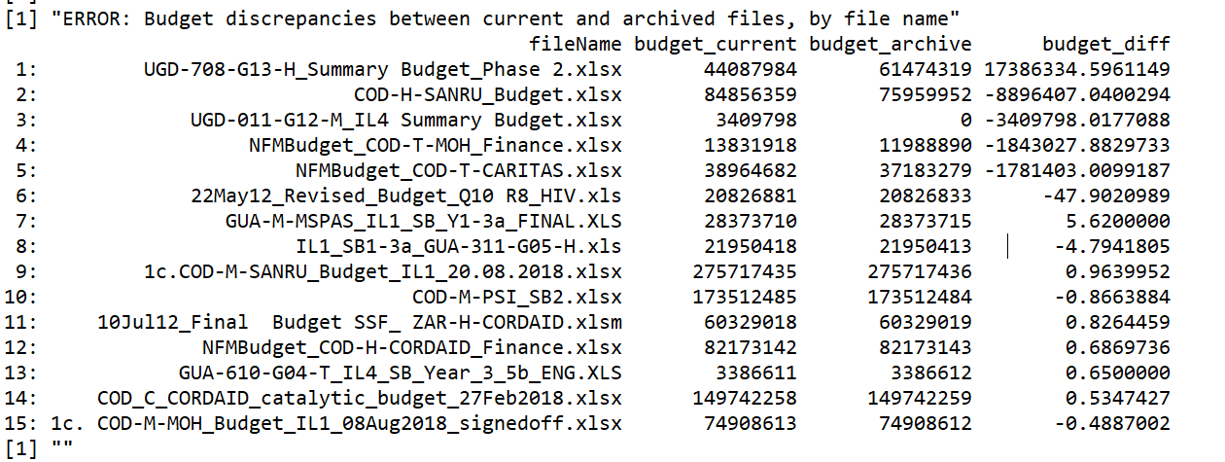
Errors in calculating final budget numbers between current and archived file

Slide 5
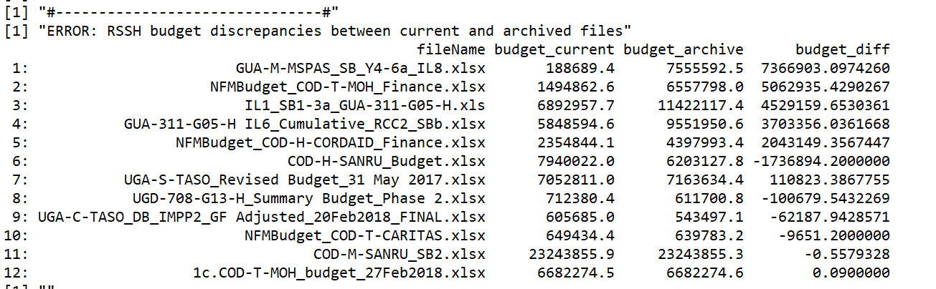
Errors in RSSH between current and archived file

Slide 6
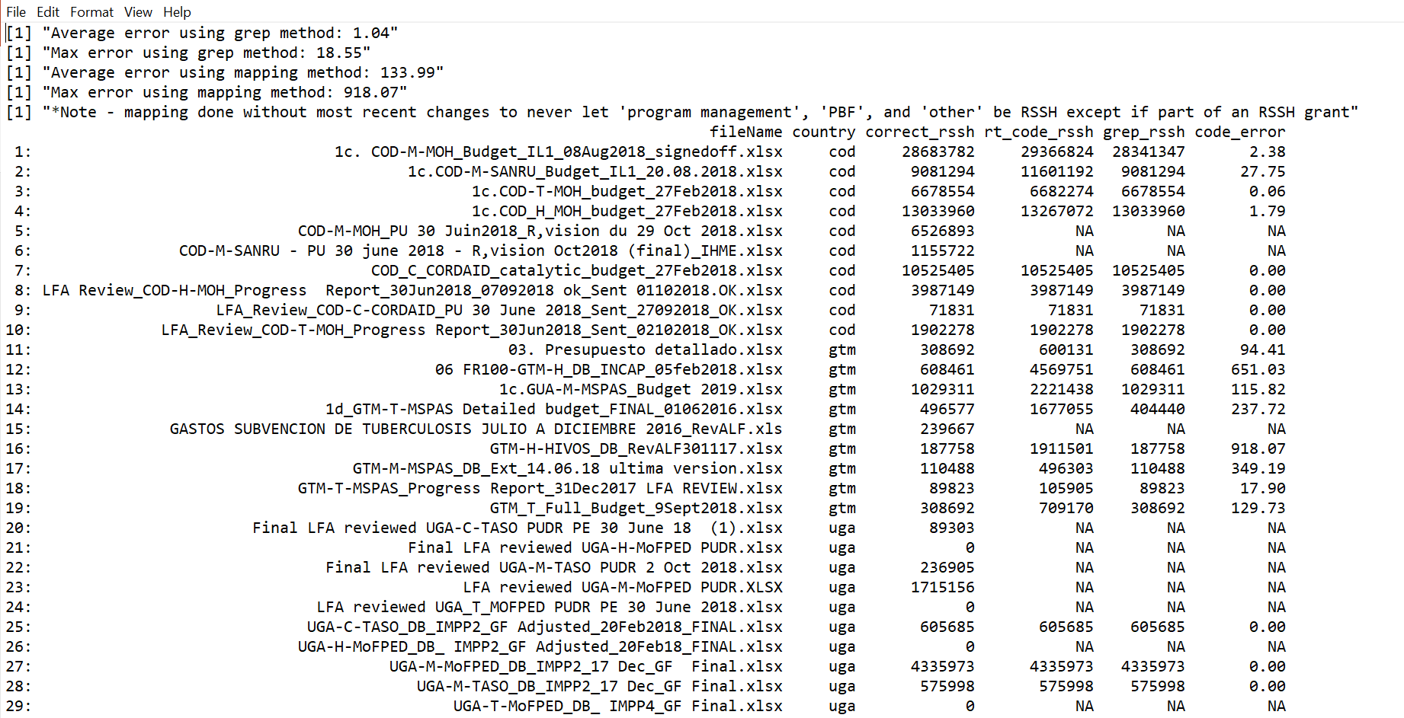
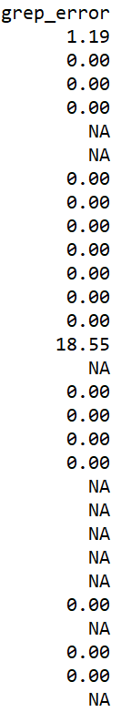
Investigation- Errors in Mapping Code

Slide 7
Investigation- Errors in Mapping Code

Slide 8
Main error sources
Notes:
The main error sources

Slide 9
NLP

Slide 10
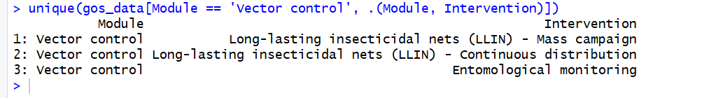
NLP
Purpose of the project was to more accurately classify line items in budgets, because it seems like errors from the country teams are common in matching activity descriptions to the modular framework.
For background, the Global Fund moved to a new grant-making structure in 2016 which included a new way of classifying financial documents, called the ‘Modular Framework’. This contains a broad category called ‘module’ and a more specific category called ‘intervention’ that help explain what money is going towards.

Slide 11
NLP
Before 2016, funds were categorized by ‘service delivery area’, which can be thought of generally as a combination of module/intervention.

Slide 12
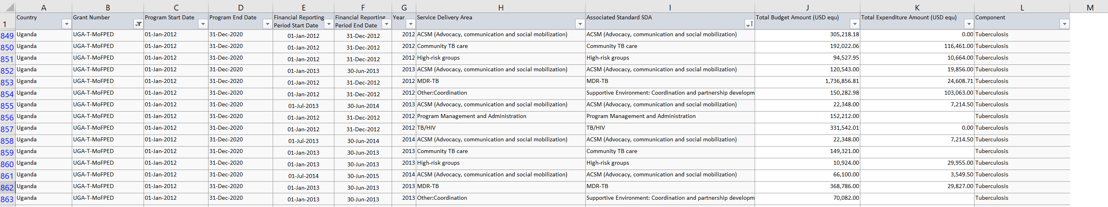
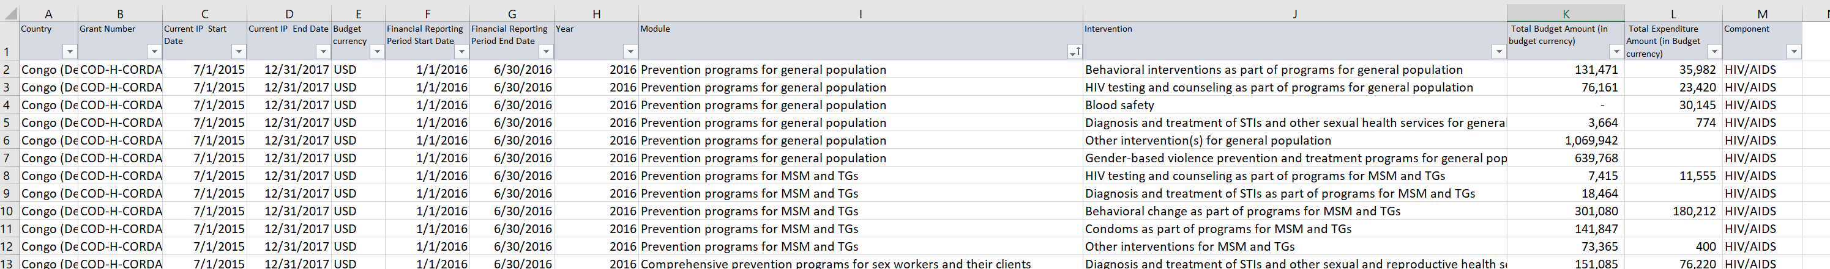
Information from GOS
Pre-2016
Post-2016

Slide 13
Information from GOS
Pre-2016
Post-2016

Slide 14
Side note-
Pre-2016
Post-2016
This is no longer a valid module under the current modular framework

